Slide 1
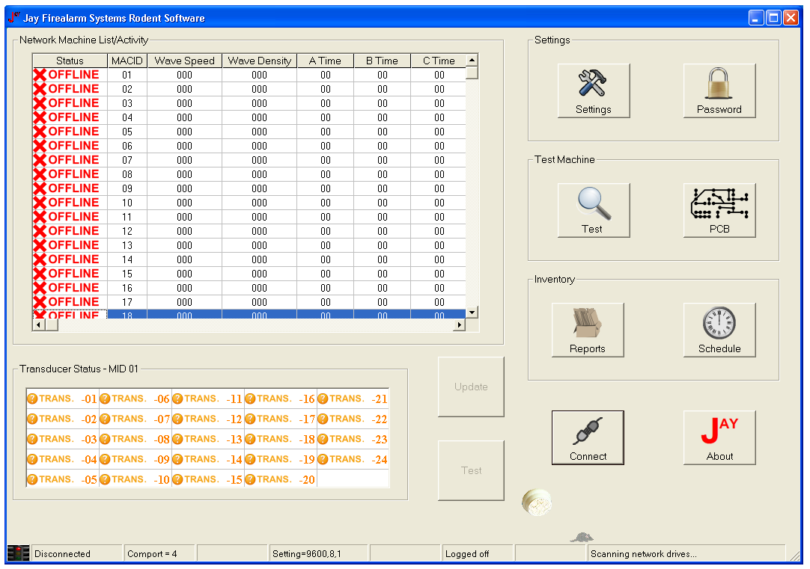
R-SCAT DIGITAL RODENT REPELLENT
Salient Features:
Centralised Reporting and Monitoring System. Facility to test all controllers in one go or in an individual mode.

Slide 2
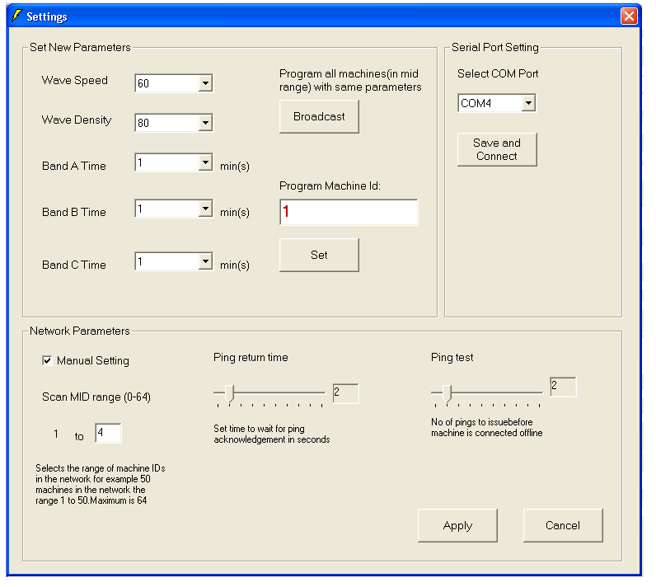
R-SCAT DIGITAL RODENT REPELLENT
Salient Features:
User friendly setup to configure number of machines , number of ping tries, ping return time. Facility to configure R-Scat Controller parameters for all controllers in one go ( braodcast) or for an individual controller.

Slide 3
R-SCAT DIGITAL RODENT REPELLENT
Salient Features:
Test Facility to check if the signal is being transmitted to the transducer from the drivers on the PCB.

Slide 4
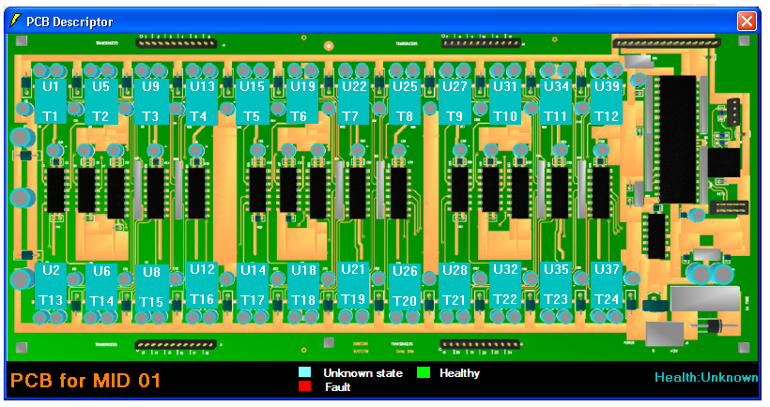
R-SCAT DIGITAL RODENT REPELLENT
Salient Features:
PCB Snapshot of the controller for facility to check transducer drivers .

