Slide 1
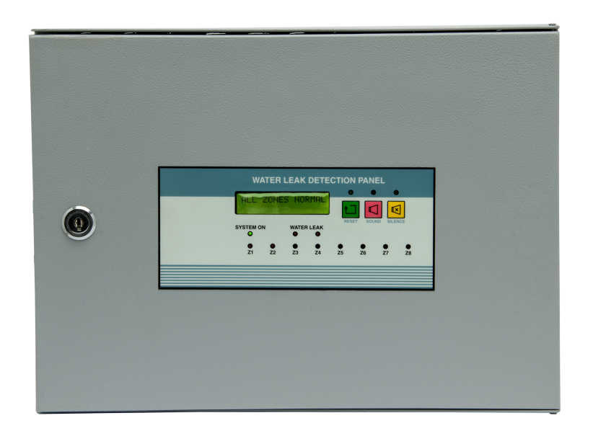
WATER LEAK DETECTION SYSTEM
Water Leak Detection Panel : Make : JAY Model JE 3523
Features: ERTL TESTED
1 to 8 zones .
Water Leak Detection Panel with built-in Modules.
Can detect leak any where along the entire cable
length.
LCD display.
Operates zone wise Potential free relay and one
common relay in case of Alarm for BMS Integration.
Built in audible sounder and common hooter output.
Easy to install and operate.
Self restoring.
Soft membrane keypad.

Slide 2
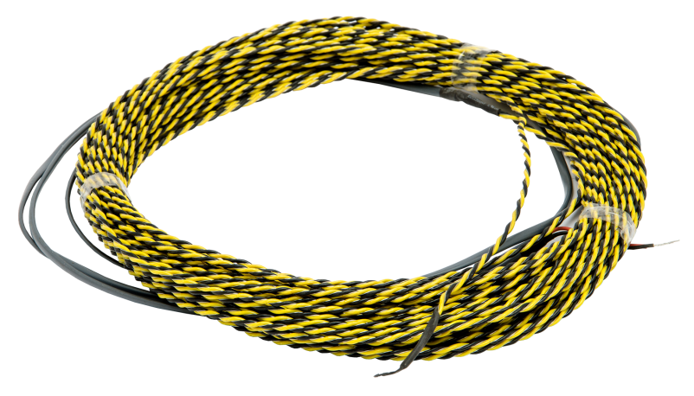
WATER LEAK DETECTION SYSTEM
WATER LEAK DETECTION
CABLE WD-CS
Features:
PVC twisted pair with stainless steel 316
elements.
The cable is restorable and corrosion resistant
and does not require replacement after being
wet.
Cable can be installed in the path of a potential
water leak.

Slide 3
WATER LEAK DETECTION SYSTEM
TECHNICAL SPECIFICATION OF WATER LEAK PANEL:
Supply Voltage : 230v AC 50Hz ± 10%
LCD Display : 16x2 Backlit
Relay Leak and Cable break type : SPDT Single Contact NO-C-NC
Audible : Sounder for alarm
External hooter output : 24v DC
Fuse : 2 Amp
Current Consumption Standby : 0.4 Amp
Current Consumption Alarm state : 1 Amp
Working Temperature : 0 to 50 ° C
Construction : Metal Enclosure wall mounted
Weight : 5 Kgs ( approx)
Size ( H X W X D ) : 270x300x115mm

Slide 4
WATER LEAK DETECTION SYSTEM
TECHNICAL SPECIFICATION OF WATER LEAK DETECTION CABLE:
Material : PVC twisted pair with stainless steel 316
elements
Leader Cable : 3 mtrs
Dimensions : 3.5mm dia
No. of Wires : Two
Max cable length : 200 mtrs
Std cable lengths : 10,15,20,25,30 and so on upto 200 mtrs.

Slide 5
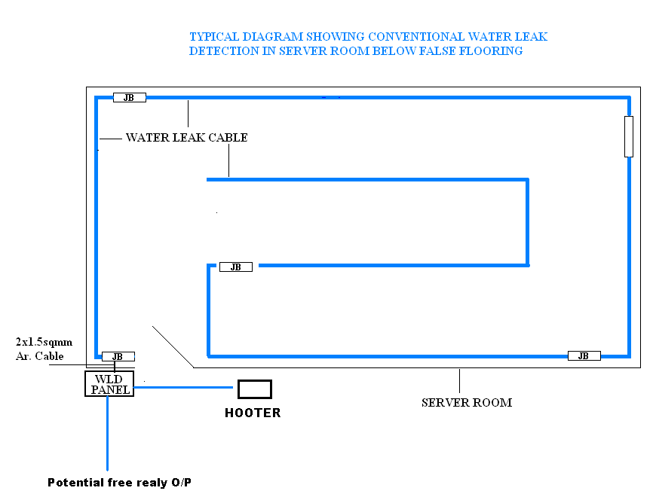
WATER LEAK DETECTION SYSTEM

